Slide 1

Counting Cards but for Equities
Group 2:
Joseph Amo Appiah
Etienne Brown
Joel Williams

Slide 2
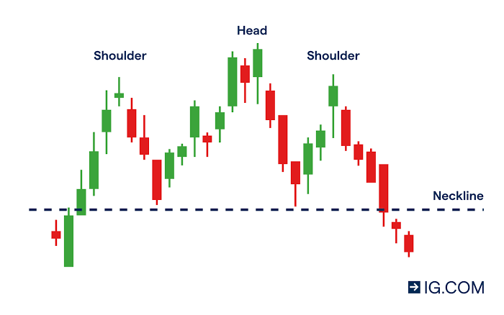
BACKGROUND AND KEY TERMS
Efficient Market Hypothesis – States that asset prices reflect all available information
Price Action – A financial analysis and speculation that generates insights based solely on price movements.
Candlestick/Bar – A chart that shows the price movement of stock during a trading day.
Bullish – A rise in share prices.
Bearish – A fall in share prices.

Slide 3

Hypothesis
Just like card counting game in blackjack, when the dealer is dealing cards, you remember those important cards and use that information to make important decisions.
Game of Probabilities
We want to apply that same principle to equities and stocks.
We created an auto trader that tested our hypothesis
To Apply the concept of counting cards to price action trading

Slide 4
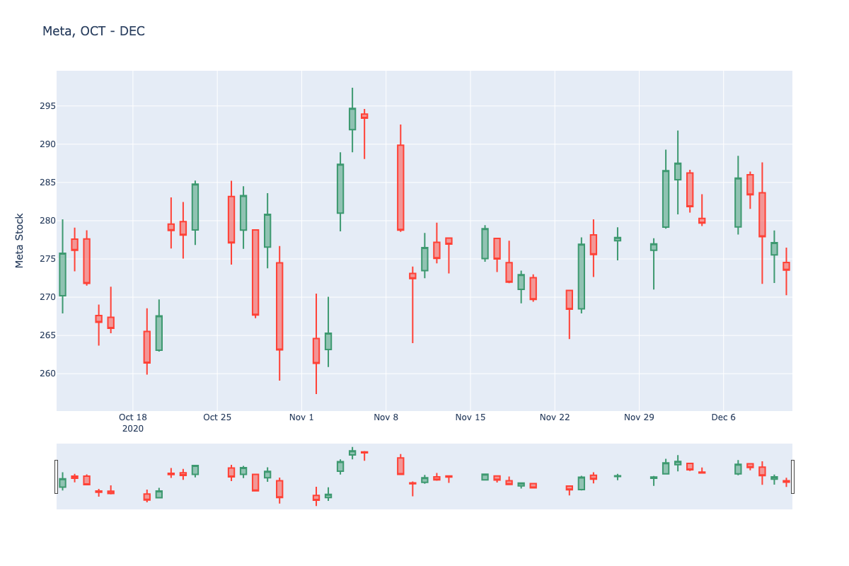
Data Display
A plotly chart of our df before processing
20XX | 20XX | 20XX | 20XX

Slide 5
LIBRARIES USED IN THIS PROJECT
API’s
OS
Hvplot
Pandas
Numpy
Plotly (New Library)
dotenv

Slide 6
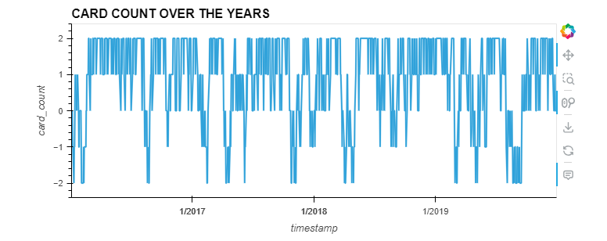
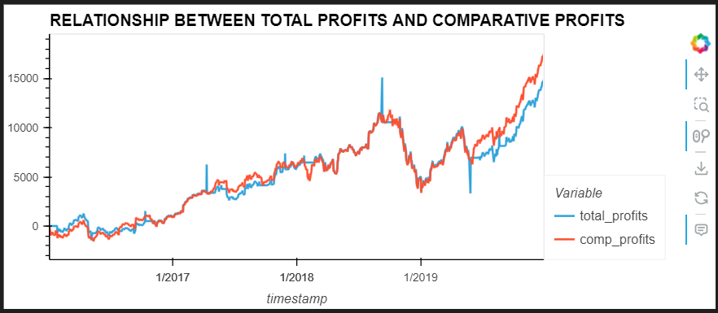
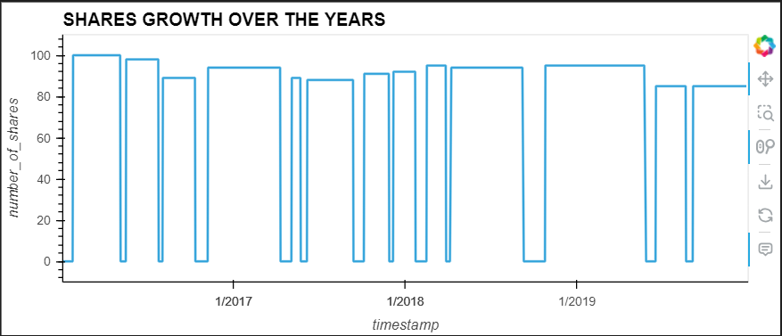
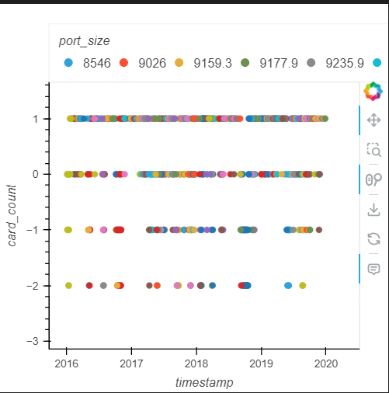
SOME PLOTED GRAPHS IN THE CODE

Slide 7
CODE RUNNING

Slide 8
CONCLUSION
Outcome Of The Code
Code completion
Code profitability or real world use
More work on Code

